Slide 1
IEEE-488

Slide 2
What does IEEE 488 mean?
IEEE-488 refers to the Institute of Electrical & Electronics Engineers (IEEE) standard number 488. IEEE-488 is a digital communications bus specification invented by Hewlett Packard and used to connect short range communication devices. This term is also known as the general purpose interface bus (GPIB) or the Hewlett Packard interface bus (HP-IB).

Slide 3
Important information about IEEE 488
In the 1960s, Hewlett Packard developed IEEE 488 to easily interconnect controllers and instruments. As a short range communication bus, IEEE 488 was easy to connect and configure.
The IEEE 488 has a 24-pin connector and is used for double headed design. Both ends of the cable are used, male on one side and female on other side.
The IEEE 488 has 16 signal lines. Eight lines are dedicated for bi-directional communication , five lines are used for bus management. The remaining three lines are dedicated for handshakes.
This allows 15 devices to be shared over a single physical bus.

Slide 4
Important information about IEEE 488
The maximum data rate is about 1 MB/sec .
Communication is digital & messages are sent one byte (8 bits) at a time.
Manage transactions are hardware handshake.
Total bus length may be up to 20m & the distance between devices may be up to 2m.

Slide 5
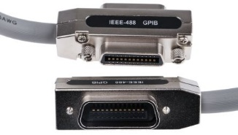
IEEE-488 GPIB (General Purpose Interface Bus)
Figure 1:
IEEE-488 GPIB

Slide 6
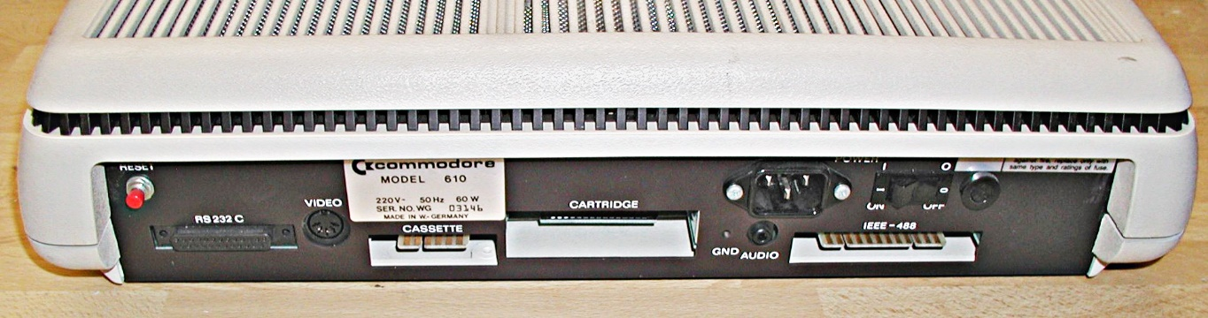
Using as a computer interface
Figure 2:
Rear of the Commodore CBM-2 , showing card edge connector IEEE 488 port.

Slide 7
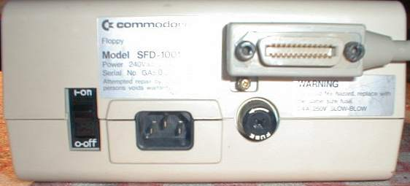
Using as a computer interface
Figure 3:
Rear of the Commodore SFD 1001 floppy disk drive with IEEE 488 port.

Slide 8
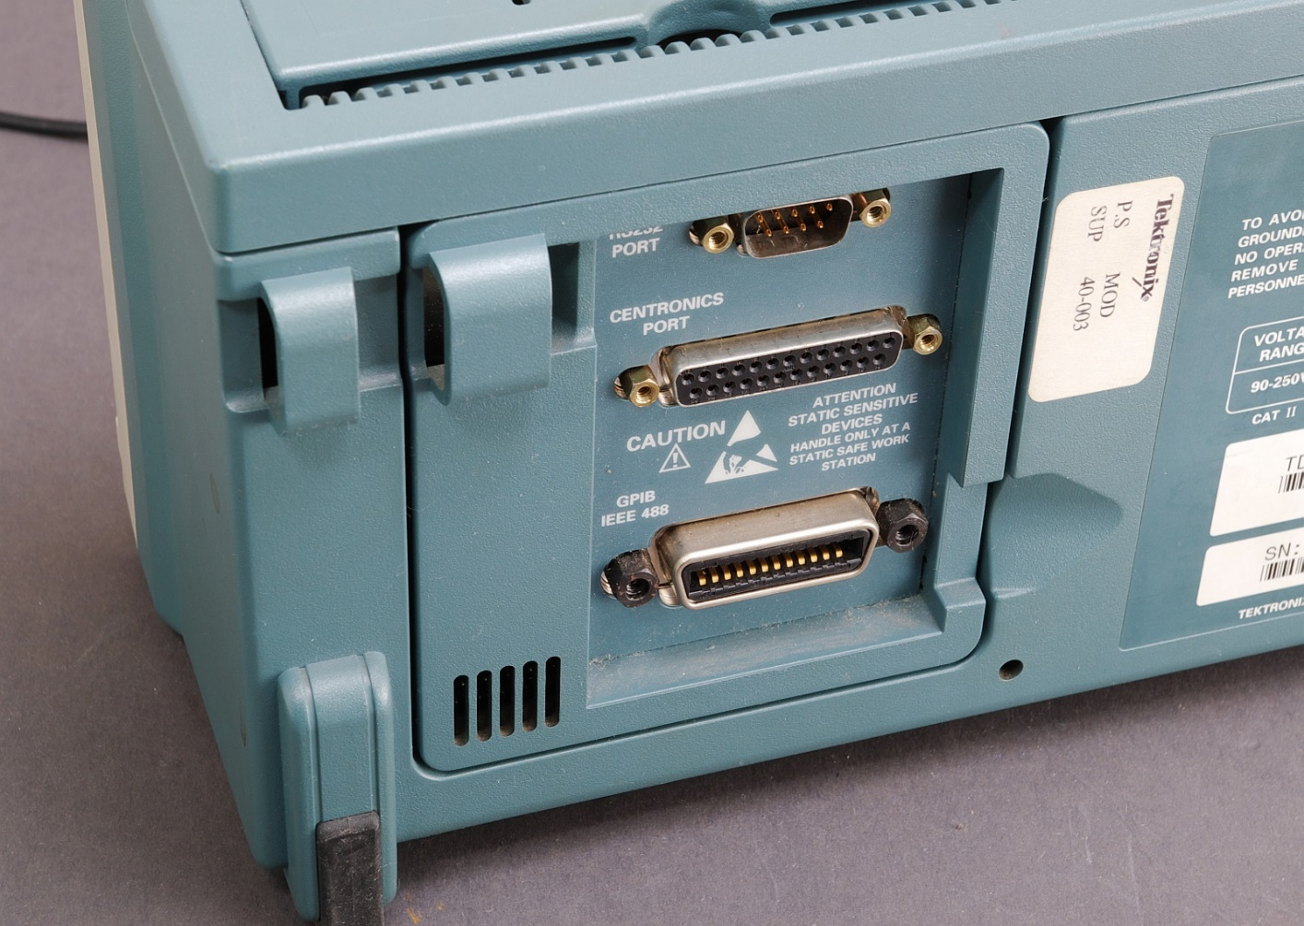
Using as a computer interface
Figure 4:
Rear of a Tektronix TDS 210 digital oscilloscope with IEEE 488 port .

Slide 9
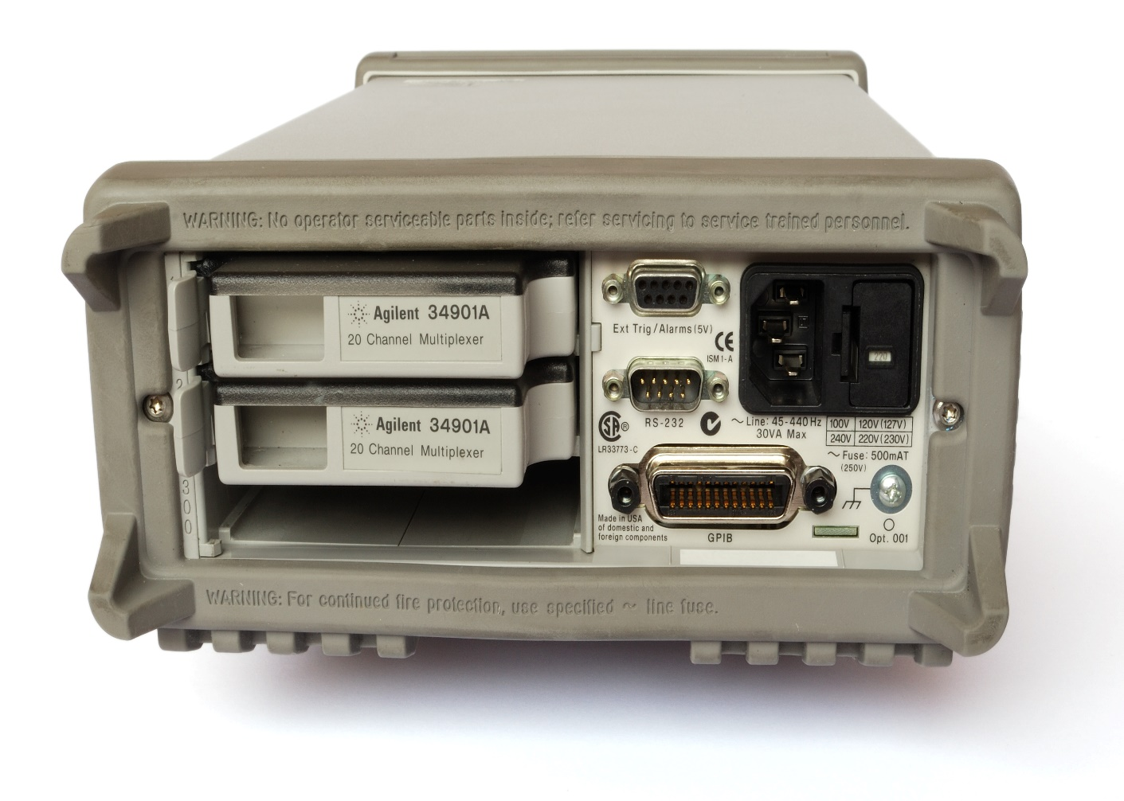
Using as a computer interface
Figure 5:
Rear view of an Agilent 34970A data acquisition chassis / multimeter .

Slide 10
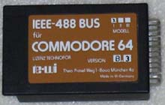
Using as a computer interface
Figure 6:
C64 interface.

Slide 11
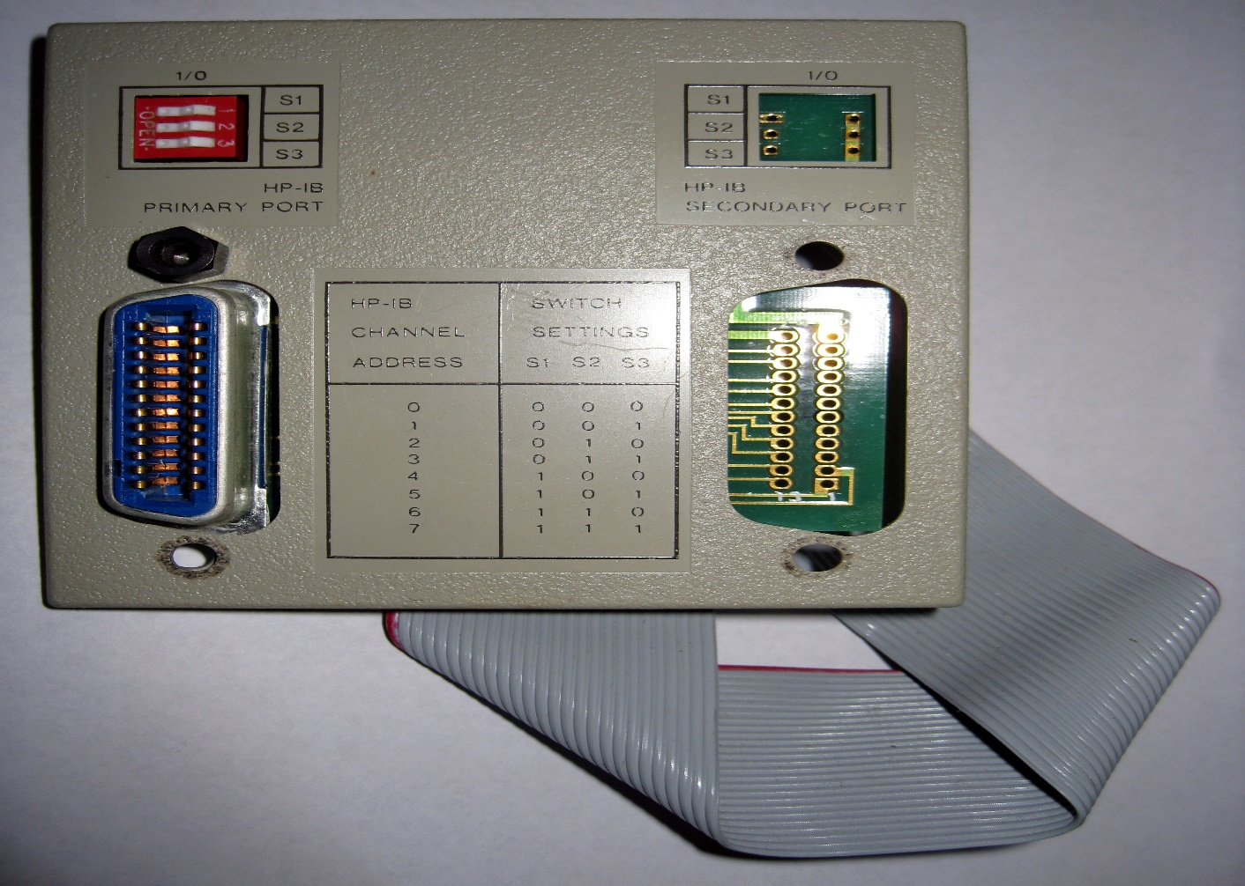
Using as a computer interface
Figure 7:
HP 7935 disc drive HP-IB Panel .

Slide 12
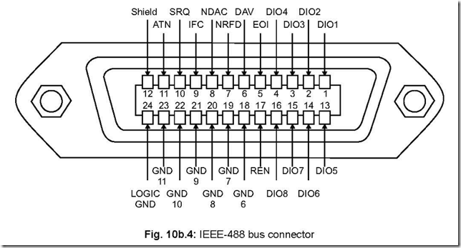
Pin configuration of IEEE-488

Slide 13
Bus lines of IEEE-488:
IEEE-488 bus is a multidrug interface in which all connected devices have access to the bus lines. The 24 bus lines group into four categories:
Data lines: 8 lines used to transfer information between devices on the bus, one byte at a time.
Handshake lines: Three lines used to handshake the transfer of information across data lines.
DAV : Data valid
NRFD : Not ready for data
NDAC : Not data accepted

Slide 14
Bus lines of IEEE-488:
Bus management lines: Five lines used for general control & coordination of bus activities.
EOI : End or Identify
IFC : Interface Clear
SRQ : Service Request
ATN : Attention
REN : Remote Enable
Ground lines: 8 lines used for shielding & signal returns.

Slide 15
Description of the operation of the following pin of IEEE-488:
ATN: Attention is used primarily to differentiate between command mode and data mode. When ATN is TRUE (I.E. Active high) information on the bus is a command and when ATN is FALSE (Active LOW) the information on the bus is data.
SRQ: Service Request can be set by a device on the interface to indicate it is in need of service. SRQ could be set at the completion of a task. E.g. finished doing a measurement, or when an error as occurred.
DAV: Data Valid is a handshake line indicating that the active talker has placed data on the data lines.

Slide 16
Description of the operation of the following pin of IEEE-488:
NDAC: Not Data Accepted is a handshake line indicating that one or more active listeners has not accepted the current data byte. Note the active talker should leave the current byte asserted on the data lines until it has been accepted or timed out.
NRFD: Not Ready For Data is a handshake line indicating that one or more active listeners is not ready for more data. Note the active talker should then wait before sending any more data on the bus. EOI: End Or identify has two uses.
EOI: is asserted on the last byte of a data transfer. This signals all devices that no more data should be expected on the transfer.

Slide 17
Advantages of IEEE-488:
Simple hardware interface.
Ease of connecting multiple devices to a single host. - Allows mixing of slow & fast devices.
Well established & mature, widely supported. –
Rugged connectors held in place by screws, means cables can’t easily be accidentally removed as they can with five wire & USB.
Rugged cables (usually). In some locations large heavily protected cables are an advantages

Slide 18
Disadvantages of IEEE-488:
Mechanically bulky connectors & cables.
Lack of command protocol standards (before SCPI) .
Implementation options can complicate interoperability in pre-IEEE-488.2 devices.
Non mandatory galvanic isolation between bus & devices.
High cost.
Limited availability.

